Slide 1
CS 6750
Human-Computer Interaction
Fall 2009
Keith Edwards
keith@cc.gatech.edu

Slide 2
Agenda
Introductions
  Me
  You
Administrative stuff…
HCI Overview
  Objectives
  Principles

Slide 3

Introductions
Instructor
  Keith Edwards
  College of Computing
  Coordinator of GT’s Computer Science Ph.D. program
  Associate Director, GVU
Research areas
  Human-network interaction
  Usable security
  Social impacts of technology
  Advanced interaction techniques
Formative experiences…
  Industry – PARC, Sun, …

Slide 4
Introductions
Your turn
  Undergrad degree and background?
  Work experience?
  Why interested in an HCI class?
  What best skill do you bring to a project team?

Slide 5
Course Information
Books
  Human-Computer Interaction, by Alan Dix, Janet Finlay, Gregory Abowd, and Russell Beale. Prentice Hall, 2004.
  The Design of Everyday Things, by Donald Norman. Currency/Doubleday, 1990.
Web
  http://www.cc.gatech.edu/classes/AY2010/cs6750_fall
  Syllabus & Class Info
  Schedule
  Assignments
  T-square (class shared webspace)
  HCI resources

Slide 6
Course Information
Grading
  Group project, 4 parts (45%)
    More details soon...
  Mid-term exam (15% total)
    Note: no final
  Homeworks (30% total)
    One week to do, likely 4 over the semester
  Participation (10% total)
    Class involvement and peer review
    Includes project involvement/effort

Slide 7
Resources
Previous courses, courses elsewhere, info on the web
HCI Digital Library
Books
Web sites
Standards documents
Go further
  Move beyond lectures & book
  Further courses
  Step into research

Slide 8
HCI
Here we go…

Slide 9
HCI What? HCI Why?
What happens when a human and a computer system interact to perform a task?
  task - write document, calculate budget, solve equation, learn about Bosnia, drive home, make a reservation, land a plane...
Why is this important?
Computer systems affect every person
Safety, satisfaction, utility is critical
Product success depends on ease of use

Slide 10
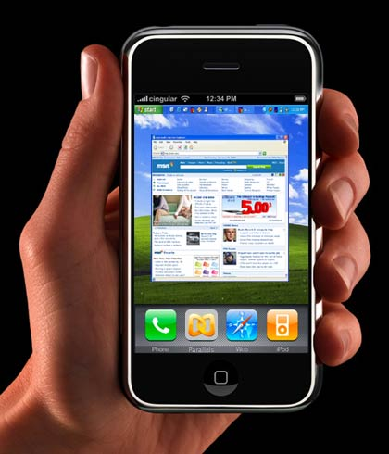

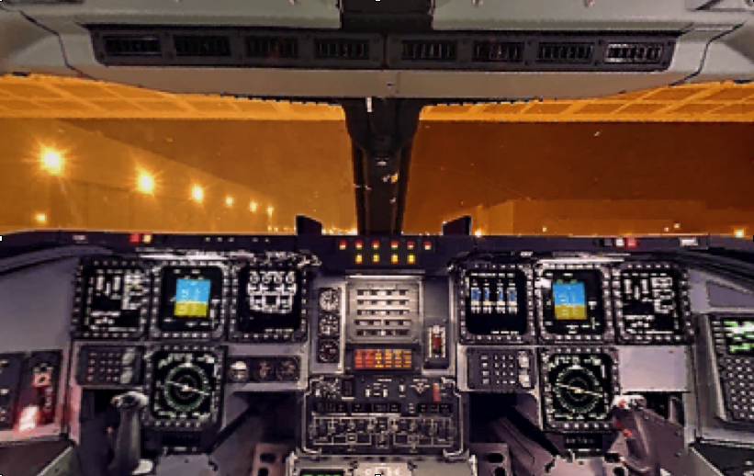
Interfaces in the Real World
Not just computers!
  VCR
  Wristwatch
  Phone
  Copier
  Car
  Plane cockpit
  Airline reservation
  Air traffic control
  Running shoes!

Slide 11
Goals of HCI
Allow users to carry out tasks
  Safely
  Effectively
  Efficiently
  Enjoyably

Slide 12
Usability
Crucial issue in this area!
Combination of
  Ease of learning
  High speed of user task performance
  Low user error rate
  Subjective user satisfaction
  User retention over time

Slide 13
HCI How?
How do we improve interfaces?
Educate software professionals
Draw upon fast accumulating body of knowledge regarding H-C interface design
Integrate UI design methods & techniques into standard software development methodologies now in place

Slide 14
UI Design/Develop Process
Tao of User-Centered Design
  Analyze user’s goals & tasks
  Create design alternatives
  Evaluate options
  Implement prototype
  Test
  Refine
IMPLEMENT
DESIGN
USE &
EVALUATE

Slide 15
Above All Else…
Know the User!
  Physical & cognitive abilities (& special needs)
  Personality & culture
  Knowledge & skills
  Motivation
Two Fatal Mistakes:
Assume all users are alike
Assume all users are like the designer

Slide 16
Design Evaluation
“Looks good to me” isn’t good enough!
Both subjective and objective metrics
Some things we can measure
  Time to learn
  Speed of performance
  Rate of errors by user
  Retention over time
  Subjective satisfaction

Slide 17
Course Overview
Human abilities
Evaluate an existing system
  (without involving users)
Design for success
Dialog & interaction styles
Evaluate your design (with users)
Special topics
  CSCW, InfoVis, Ubicomp, Agents, Audio

Slide 18
Upcoming
History & Frameworks of HCI
Project info
Futuristic scenarios
Design of Everyday Things (DOET)
Start reading...
  DFAB (note order of chapters)
  DOET

Slide 19
Group Project
Semester-long team effort

Slide 20
Group Project
Design and evaluate an interface
  0 - Team formation & topic choice
  1 - Understand the problem space
  2 - Exploring the design space
  3 - Prototype
  4 - Evaluation
Main 4 parts worth ~10% each
Presentation, documentation ~ 5%

Slide 21
Group Project Details
Part 0 - Topic definition
  Identify team & general topic
  Create web notebook (on T-square)
  Suggestion: Pick a population and pick a technology; check out intersection
Part 1 - Understanding the problem
  Describe tasks, users, environment, social context
  What are implications for design?

Slide 22
Group Project Details
Part 2 - Design alternatives
  Storyboards, mock-ups for multiple different designs
  Explore, push boundaries of design space
  Explain decisions
Part 3 - System prototype & eval plan
  More detailed prototype (semi-working ok)
  Plan for conducting evaluation

Slide 23
Group Project Details
Part 4 - Evaluation
  Conduct formal evaluation with example users
  Use appropriate methods
  Analyze results of evaluation
  Characterize what’s working and what’s not

Slide 24
Presentations
Midterm poster session
  Feedback on ideas, whole class period
  After Part 2 (near midterm)
  Other students and “expert” gallery (hopefully)
Final poster session (2 days)
  Week 15 of the semester

Slide 25
Project Teams
2 people
  You decide (or I will!)
  Diverse is best!
  Consider schedules
  Use the T-square web space:
    Immediately post ideas for general topics, populations, technologies, etc.
    t-square.gatech.edu
Cool project and team name

Slide 26
Project Topics
Semester theme: “Innovative Interfaces in Everyday Life”
  ?? What does this mean ??
General Topic:
  “Phase 0” of the project
  Set up web notebook on T-square

Slide 27
What Makes a Good Project
Typically:
  Access to domain experts & users
  “Real” clients
  Interesting human issues
  Rich domain for design
Theme has a LOT of range for topics

Slide 28
Previous Topic Ideas
Mobile/handheld (cars, tour guides, etc.)
Wedding planner
GIS
Calendar agent (speech)
Audio / Web sites
Domain that you know well

